Slide 1


ARDUINO BASED AUTOMATED PLANT WATERING SYSTEM
A mini project report on
Mini Project Done At
PANTECH SOLUTIONS PVT.LTD.
Ameerpet,Hyderabad.
Under the guidance of
Ms.Hemasri(Project Engineer).
BY,
A.DhananjaySai (17265A0201)
P.Neeresh Kumar (16261A0260)
J.Pratheek (15261A0215)

Slide 2
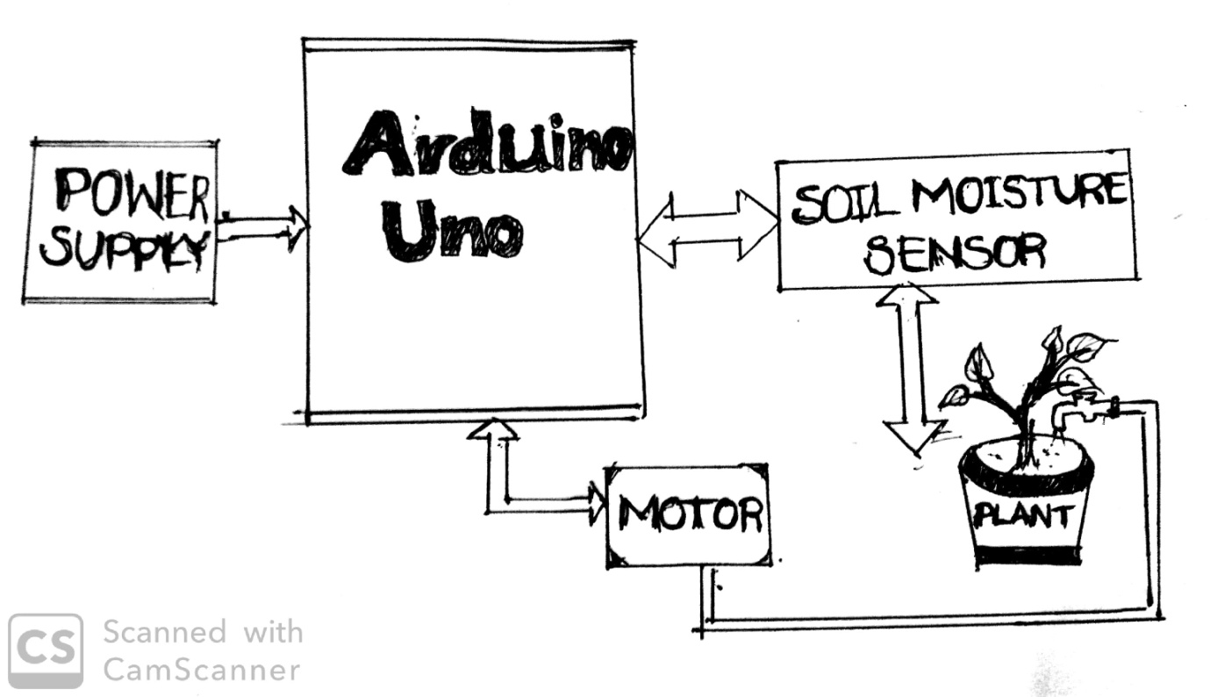
What the project is all about..!
An important aspect of this project is that: “when and how much to water”. To reduce manual activities for the human to watering plant, an idea of automatic plant watering system is adopted.
This project uses Arduino board, which consists of ATmega328 Microcontroller. It is programmed in such a way that it will sense the moisture level of the soil (plants) and supply the water if required.

Slide 3
What is ‘Automation’..?
Automation is the creation of technology and its application in order to control and monitor the production and delivery of various goods and services.
It performs tasks that were previously performed by humans.
Advantages of Automated System
Conserves water&time.
Preserves soil structure&nutrients.
Gardening flexibility.
Improved safety&less power consumption.

Slide 4
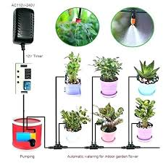
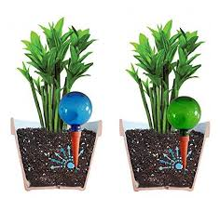
Background Of The System
Indoor Drip Watering System
Using Globes&Spikes

Slide 5
Hardware Required.
Arduino UNO.
YL-69 Soil Moisture Sensor.
LM-393 IC (Electronic Board ).
DC-Motor(0.5-6volts).
USB Type-B Cable.
Personal Computer.

Slide 6
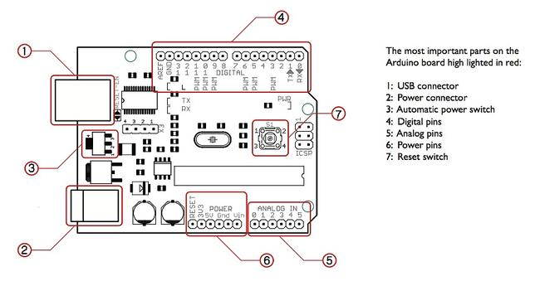
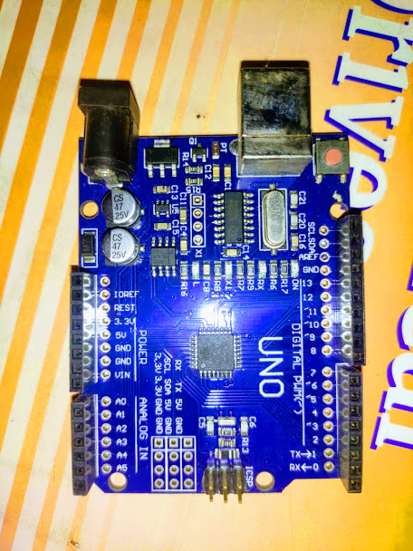
1.Arduino Uno.

Slide 7
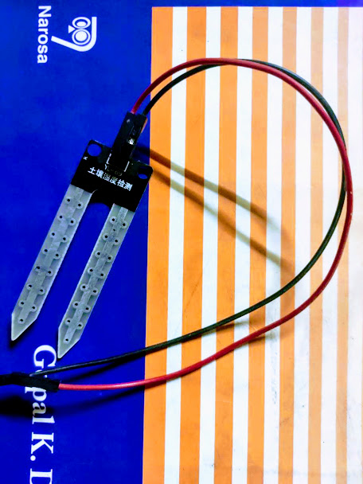
2.Soil Moisture Sensor.
This sensor is used to detect the moisture in the soil and give the readings back to the microcontroller. It is consisting of two probes which are used to measure the volumetric content of water around it.

Slide 8
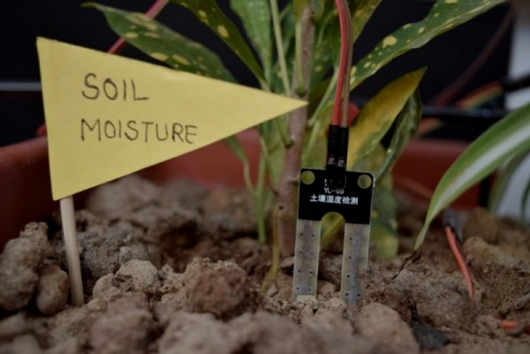
Soil Moisture Sensor When Inserted In Soil

Slide 9
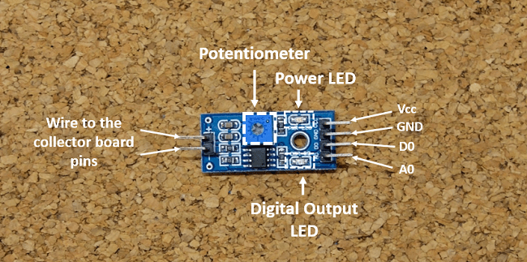
3.LM-393 IC(Electronic Board).
The sensor has a built-in potentiometer for sensitivity adjustment of the digital output (D0).

Slide 10
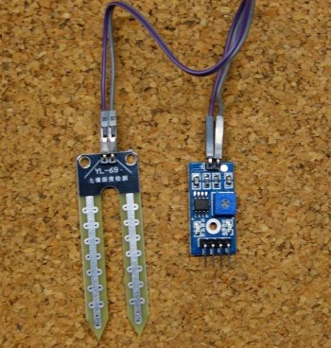
YL-69 Soil Moisture Sensor.

Slide 11
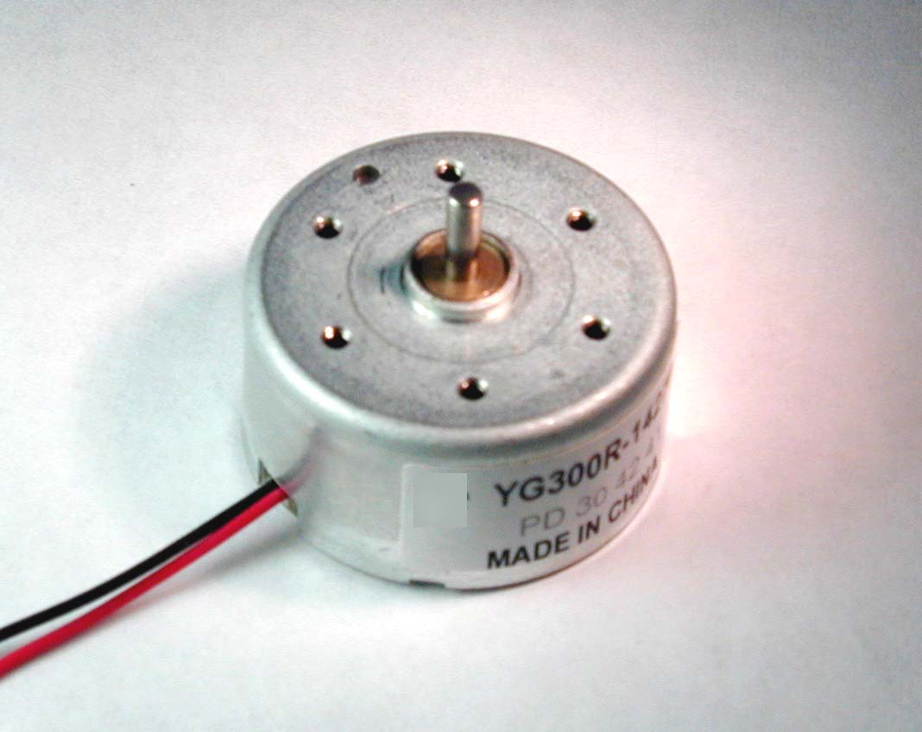
4.DC Motor.

Slide 12
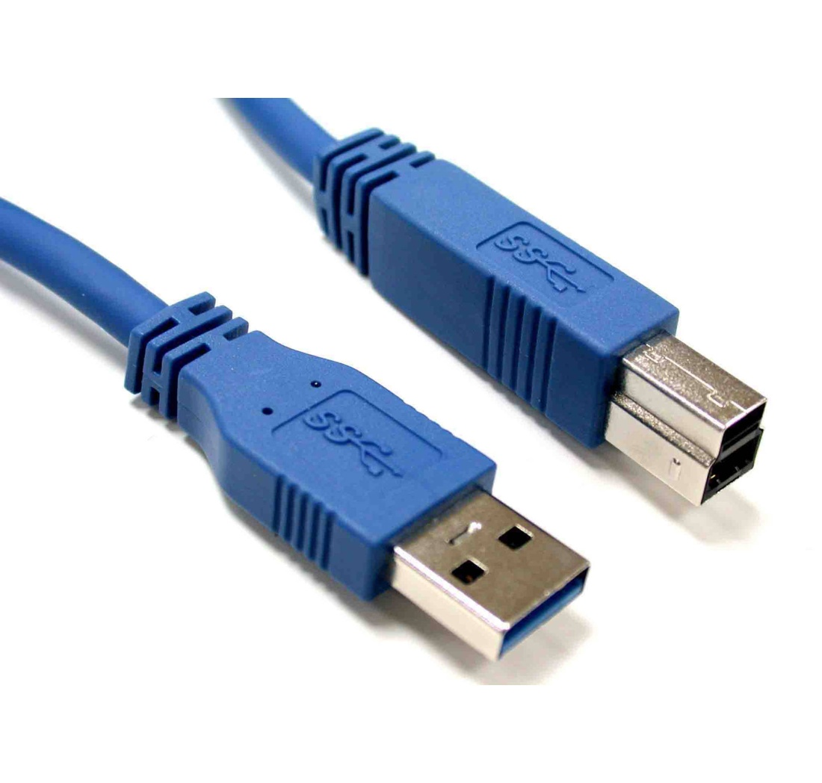
5.USB Type-B Cable.

Slide 13
Arduino IDE(Integral Development Environment)
The Arduino integrated development environment (IDE) is a cross-platform application written in Java, and is derived from the IDE for the Processing programming language and the Wiring projects.
The Arduino Uno board can be programmed with the Arduino software.
For the basic Circuit shown,it is designed to turn On the water pump when the moisture level of soil crosses a predefined value .

Slide 14
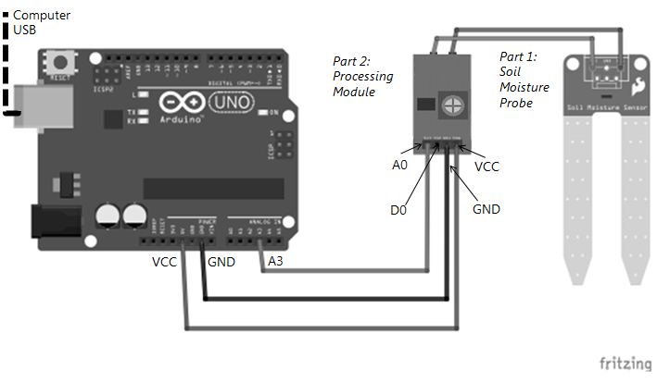
Construction&Working
Connection diagram

Slide 15
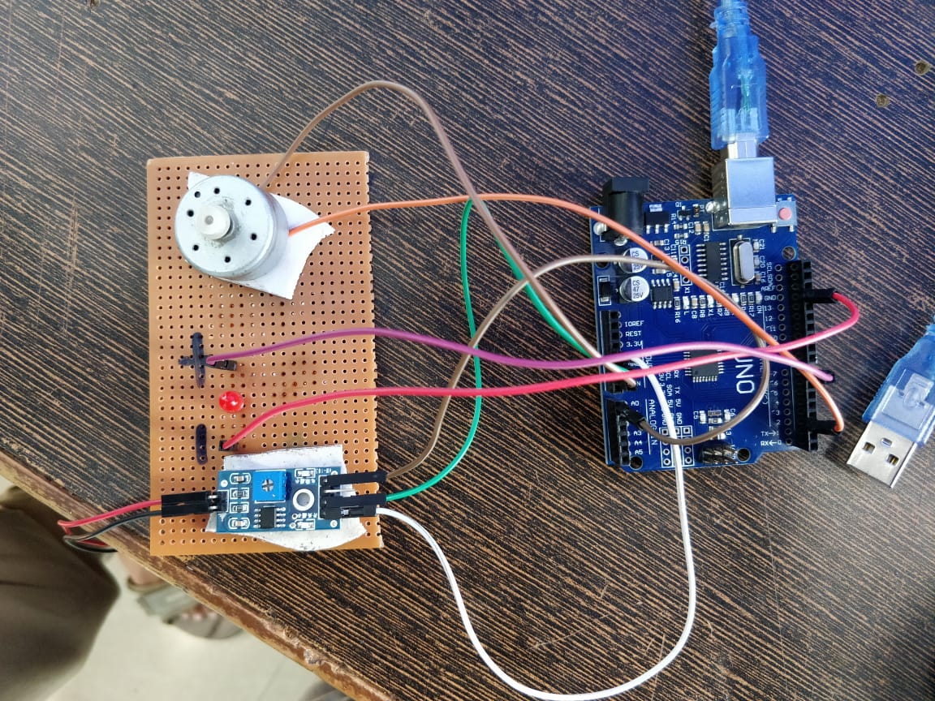
Wiring Diagram

Slide 16
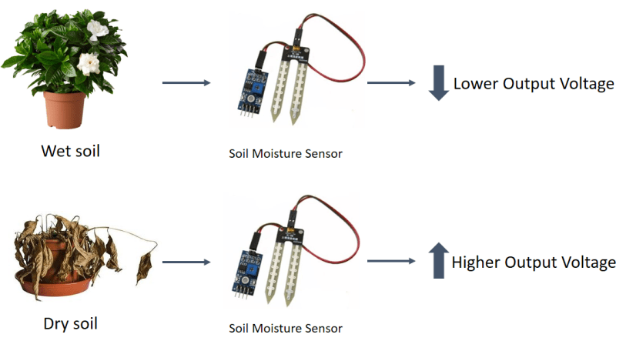
Working:
Modes Of Operation

Slide 17
Advancements
Use of wired systems in remote areas is usually unfeasible due to high costs, wireless is the best solution.
GSM (Global System for Mobile Communications,) module is used for sending SMS to the user.So that the user gets message/remainder everytime on his/her mobile phone when the motor is turned ON/OFF,If required.
Conclusion
Overall, this Arduino based automatic plant watering system is beneficial in terms of encouraging planting without the need of human effort. We hope that, through this prototype people will enjoy having plants without the challenges related to absent or forgetfulness.

Slide 18

THANK YOU….

